Slide 1
Team 0- Weather Forecasting RNN
By: Liza Abraham, Matthew Grech, Mitchell Palermo, Andrew Radke

Slide 2
Problem- Forecasting Accurate Weather Data
What is the Problem?
Weather Forecasting is a complex task
Other weather forecasting methods are outdated and less accurate
Numerical
Statistical
Rule based
There is always room to improve when forecasting the weather
Why is Weather Forecasting Important?
Accurate weather predictions:
Save lives
Support Disaster Preparedness
Optimize sectors including
Agriculture
Transportation
Renewable energy generation
Notes:
Within the first couple minutes of the presentation, the audience can clearly understand why the
problem is interesting or important.
The audience has a clear picture of the kind and amount of data you are working with, and any
potential limitations of your data.
A TA in the audience should be able to come up with rudimentary ideas of how to solve your
problem based on the information presented in the first couple minutes.
The audience is aware of any nuances that makes the problem easier or harder than what someone
might expect.
———————————————————————————————————————————————————————————————————
Weather forecasting is a complex task due to the inherent unpredictability and chaotic nature of the Earth's atmosphere. Meteorologists have traditionally relied on various numerical models and statistical techniques to make forecasts. However, with advancements in machine learning and deep learning, there has been a growing interest in utilizing these approaches to enhance weather predictions. There is always room to improve when forecasting the weather since predictions can get more accurate when looking further and further into the future. As time passes deep learning, including our model, will play the biggest role in pushing weather forecasts to achieve this, which is important because …
*next box
Weather forecasting is not only a matter of convenience but a crucial aspect of modern life, impacting numerous industries and daily activities. Accurate weather predictions can *read list.

Slide 3
Problem- Forecasting Accurate Weather Data
Historical Weather Data from:
Government of Canada
Metrics:
Rainfall (mm)
Relative Humidity (%)
Temperature (ºC)
Wind Speed (km/h)
Nuances:
Extreme Weather Events
Spatial Variations
Seasonal changes
Climate Change
Available Data and Nuances

Slide 4



Data Processing- Creating the Data frame
Step 1: Data Downloading
Step 2: Data Loading
Step 3: Data Manipulation
Government of Canada csv files
Google Drive Folder
Use panda’s function to combine all the csv files into a single pandas dataframe
Sort chronologically
Cast columns to appropriate data types
Drop null values
Drop unneeded columns(time, date etc.)

Slide 5
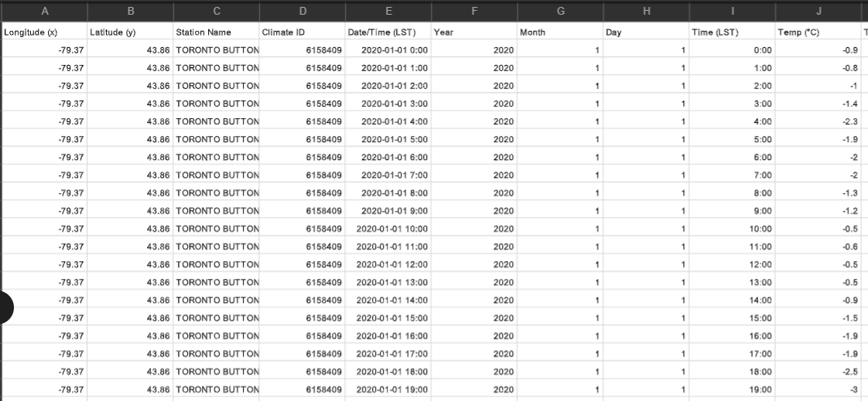
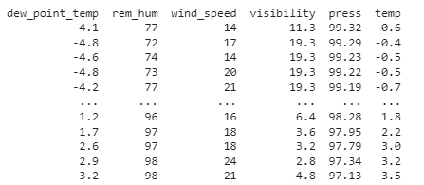
After Data Processing
Raw Data from CSV
Cleaned Up Data Frame

Slide 6
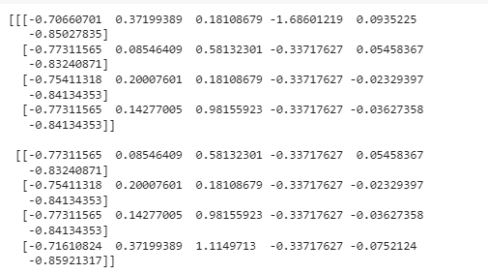
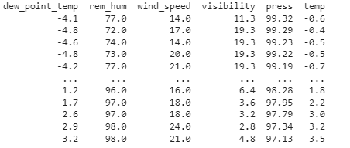
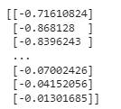
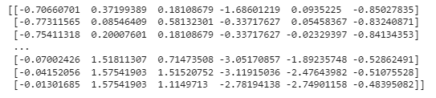
Data Processing- Creating Loaders
Step 1: Data Standardization
Step 2: Define Input & Target Datasets
Transform using StandardScalar() from sklearn library data & cast to numpy array
Inputs Dataset: For each prediction, they model will look at the past 4 hours and all 6 features so shape will be (26284, 4, 6)
Target Dataset: The model is looking to predict the temperature of the next hour, so target dataset will has a shape of (26284, 1)

Slide 7
Model - Choice of Architecture
Criteria
CNN
Arima
LSTM
1
Data Handling
Grid Like
Time Series
Sequential data
2
Temporal Patterns
Short-Term Dependencies
Captures long-term dependencies
3
Handling Variable Length
4
Long-Term Memory
5
Suitability for Problem
Limited
Moderate
Best
Notes:
Data Handling:
LSTM is designed to handle sequential data, making it suitable for weather time series.
ARIMA is designed for time series data but lacks the ability to handle sequences directly.
CNN is designed for grid-like data, such as images, which is not the natural format of weather time series.
Temporal Patterns:
LSTM excels at capturing long-term dependencies, essential for capturing seasonality and complex weather patterns.
ARIMA is limited to capturing short-term dependencies and struggles with long-range patterns.
CNN does not inherently capture temporal patterns and may not effectively model weather time series.
Long-Term Memory:
LSTM uses its gating mechanism to maintain long-term memory, which is crucial for accurate weather predictions.
ARIMA lacks long-term memory and is more suitable for stationary time series.
CNN does not have a memory mechanism and is not designed for time-dependent sequences.
Handling Variable Length:
LSTM can handle variable-length sequences, which is common in weather data due to irregular observations.
ARIMA requires equally spaced time intervals and struggles with missing data points.
CNN is not designed for handling variable-length sequences and may require data padding.
Performance in Forecasting:
LSTM outperforms ARIMA and CNN in weather forecasting due to its ability to capture long-term dependencies and handle sequential data effectively.
ARIMA provides moderate forecasting performance but may struggle with non-linear and complex weather patterns.
CNN is not specifically designed for forecasting time series data and may not perform well in this context.
Complexity:
LSTM has moderate complexity with its cell structure, but its performance justifies the computational cost.
ARIMA is relatively simple compared to LSTM, but its forecasting power may be limited in complex weather scenarios.
CNN's complexity lies in its convolutional layers, but its application is more suitable for image processing.
Suitability for Weather Forecasting:
LSTM stands out as the best choice for weather forecasting tasks, given its strengths in handling sequential data, capturing long-term dependencies, and exhibiting superior performance.

Slide 8
Model - Choice of Settings
Input Size and Type:
The most prominent atmospheric factors that predict future temperature are determined to be the following features [link here]
The ideal amount of data preceding the hour the model will forecast was found experimentally.
Prediction Window: 4 hour window of data is ingested by the model to predict the next hour’s temperature
Prediction parameters: Temperature, Humidity, Dew point, wind speed, pressure, visibility
Model Size:
Through experimentation with our data we have determined the best size for this network.
Number of Layers: 1
Number of Nodes per layer: 32
Model Functions:
Industry standards and most common used formulae helped determine which activation, loss, and optimizer would be used
Activation Function: ReLU
Loss Function: Mean Squared Error
Optimiser Function: adam
Additional Features - Dropout:
Experimental results helped determine the ideal amount of dropout and regressive dropout in the network.
Standard Dropout: .2
Regressive Dropout: .3

Slide 9
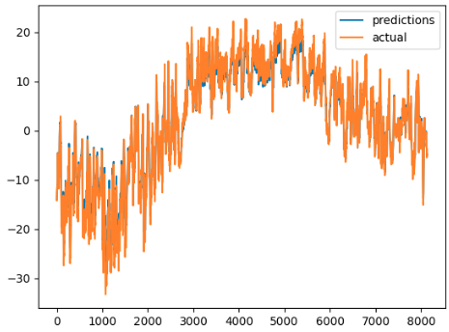
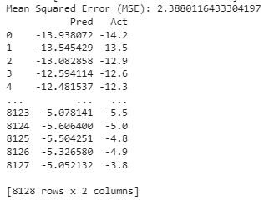
Results - Qualitative
Temperature
Hours

Slide 10
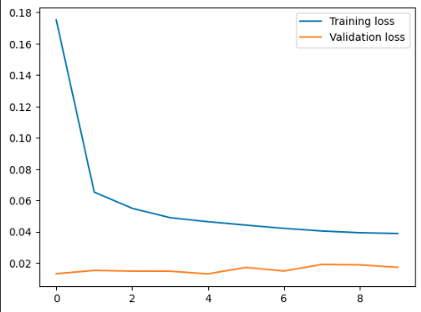
Results - Quantitative
Model uses mean squared error
Validation error was 1.37°
Testing error was 1.5°
Loss reaches a minimum of 0.05
Loss
Epoch

Slide 11
Model Demo
Link: here

Slide 12
Thank you!

